Slide 1
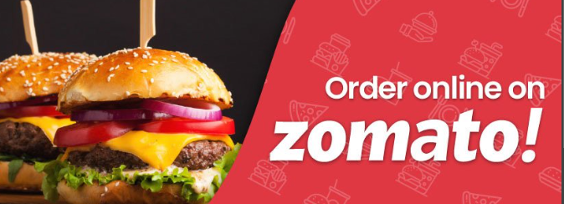
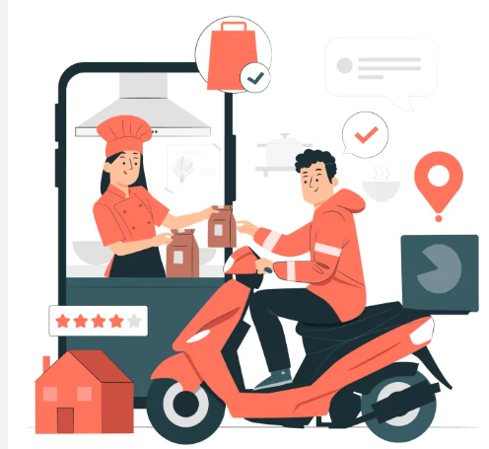
Topic:
Zomato Sales Analysis
Team: Group 6
1. Indrajit Chowdhury
2. Srishti Mankoti Mehra
3. Ranjitha Muthukrishnan

Slide 2

Objective
The basic objective of analyzing the Zomato dataset is to gather insights about the factors affecting the establishment of different types of restaurant at different places in India.
Some of the factors analysed in the projects are:
Focus on High-Performing Locations
Analyzing Cuisine data and Restaurant Preferences
Dynamic Pricing and Seasonal Promotions
Customer Engagement and Feedback
Monitor Performance Regularly and Adapt

Slide 3
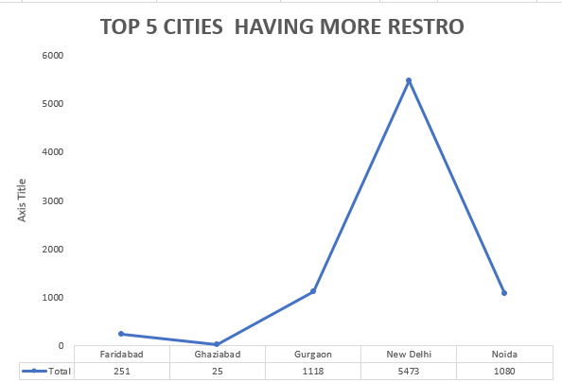
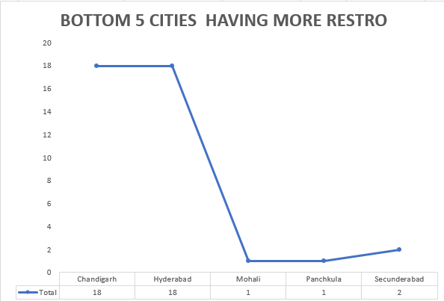
Focus on High-Performing Locations
Key Insight: Some cities are significantly outperforming others in terms of orders, revenue, and customer engagement. These high-performing locations should be prioritized for stock (partner restaurants), marketing resources, and exclusive promotions.
Recommendation:
Focus on Top Cities/Regions: Increase restaurant partnerships, expand inventory of popular cuisines, and tailor marketing efforts to high-performing cities like Delhi, Noida, Gurgaon. Ensure these areas consistently have availability of high-demand items to maintain growth.
Revitalize Underperforming Cities: We need to Investigate why specific cities or regions are underperforming (e.g., limited restaurant options, low customer engagement). Consider running hyper-localized promotions, offering discounts or loyalty programs, and expanding restaurant options to boost orders. It might also be beneficial to increase delivery efficiency or add more delivery partners to reduce wait times in these areas.

Slide 4
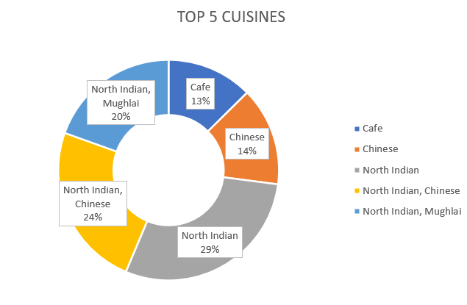
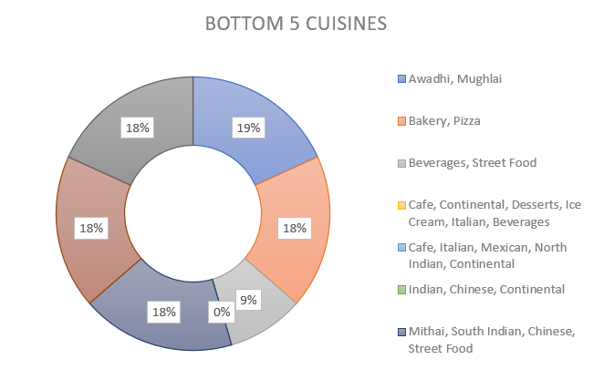
Analyzing Cuisine and Restaurant Preferences
Key Insight: Different regions have different preferences for cuisines, and certain restaurant partners or food types are more popular in some locations. This regional data can guide inventory, product offerings, and marketing strategies.
Recommendation:
Promote High-Performing Cuisines/Restaurants: Use targeted marketing (e.g., city-based ads, geo-targeted push notifications) to promote top-selling cuisines and restaurants that are performing well in specific areas, such as Mughlai in Hyderabad or street food in Delhi. Ensure these are prominently featured on the app.
Reevaluate Underperforming Categories: Review restaurants or cuisines that are underperforming and consider localizing promotions (e.g., offering discounts on underperforming cuisines) or re-engaging customers with special campaigns. You might also consider partnerships with new, trending restaurants or expanding to regional favorites that have not yet been included on the platform.

Slide 5
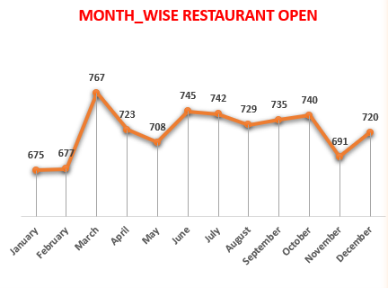
Dynamic Pricing and Seasonal Promotions
Key Insight: Sales trends show that demand fluctuates based on local events, holidays, and even weather patterns. Zomato can use this data to implement dynamic pricing strategies and time-based promotions to maximize revenue.
Recommendation:
Implement Dynamic Pricing: Use demand-based pricing to adjust rates for delivery charges, premium restaurants, or certain cuisines during peak hours (e.g., during lunch or dinner times) or around major holidays. For example, offering surge pricing during festivals like Diwali, or running a discount during off-peak hours, can help optimize sales.
Seasonal Promotions: Plan special campaigns around Indian festivals (e.g., Eid, Diwali, Durga Puja) or national holidays like Independence Day to run limited-time discounts, bundle offers, or restaurant-specific promotions. A well-timed flash sale or a festival special can increase customer engagement and drive orders during traditionally low periods.

Slide 6
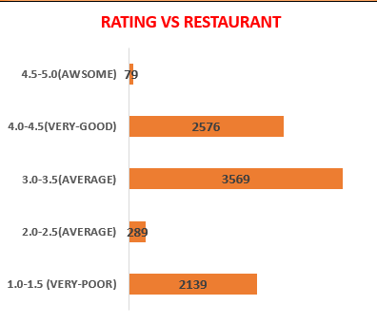
Customer Engagement and Feedback
Key Insight: Understanding customer preferences through feedback can help Zomato tailor its offerings and resolve any issues affecting underperformance in specific cities or restaurants.
Recommendation:
Collect Customer Feedback: Use in-app surveys, ratings, and social media to gather direct feedback on customer preferences, delivery experience, restaurant quality, and app usability. This will help identify why some restaurants or services are underperforming and how Zomato can improve.
Expand Loyalty Programs: Continue expanding and enhancing Zomato Gold or other loyalty offerings. Consider offering rewards not just for repeat orders but also for social sharing, reviews, and referrals. Encourage customers to refer friends for rewards, increasing both engagement and customer acquisition across cities.

Slide 7
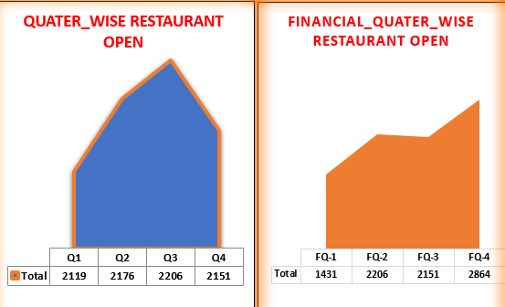
Monitor Performance Regularly and Adapt
Key Insight: Sales performance data is essential for understanding trends, optimizing offers, and continuously improving customer satisfaction. Regular performance monitoring helps Zomato remain agile in adapting to shifts in market demand.
Recommendation:
Regular Performance Reviews: Implement monthly or quarterly audits to track performance across cities, restaurant categories, and user feedback. Use this data to adapt campaigns, shift resources, or address issues like delivery delays, restaurant partner dissatisfaction, or pricing concerns in real time.

Slide 8

Conclusion:
By aligning Zomato’s resources and marketing strategies with high-performing locations, optimizing restaurant offerings based on regional preferences, enhancing cross-channel strategies, and implementing dynamic pricing, Zomato can maximize its potential across India. Regularly engaging with customers, collecting actionable feedback, and leveraging data-driven insights for promotions and loyalty programs will further improve customer satisfaction, drive orders, and strengthen Zomato’s position in the highly competitive Indian food delivery market.
THANK YOU ALL PLEASE LET ME KNOW IF YOU HAVE ANY QUERY

